Slide 1
2nd Floor Front– Lounge/Breakout Area

Slide 2
2nd Floor Lounge Seating Alcove

Slide 3
2nd Floor Front Lounge Pantry Area

Slide 4
2nd Floor Front Pantry Mill Work

Slide 5
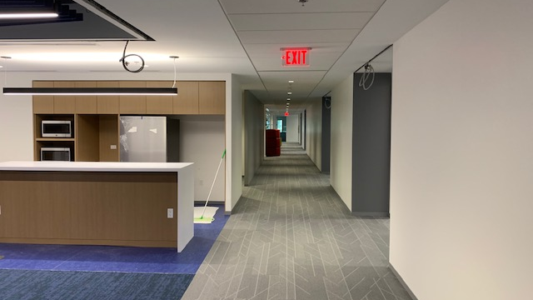
2nd Floor Classroom Row (Eastside)

Slide 6
2nd Floor Middle Row Classroom

Slide 7
2nd Floor Rear Breakout Area
Also shows open area furniture that will be placed throughout facility.

Slide 8
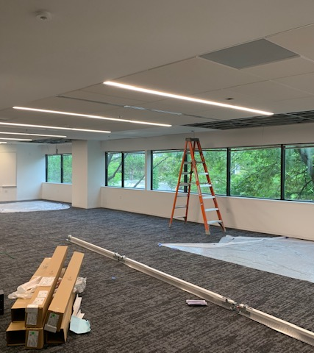
2nd Floor Multi-purpose Room
Replaces 268/270

Slide 9
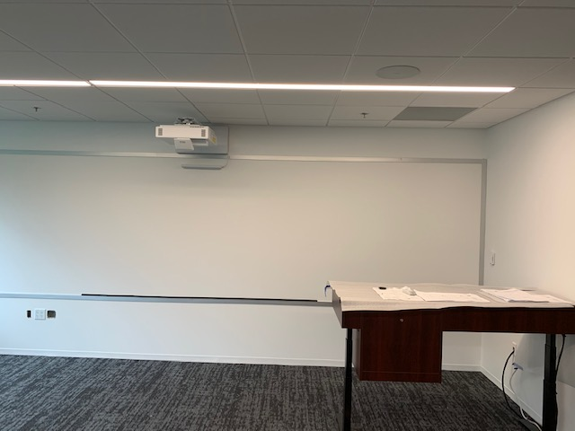
2nd Floor Classroom AV System
Instructor Station has motorized height adjustment

Slide 10
Welcome Center View
Yes, the staircase lighting is as seen!

Slide 11
Welcome Center Desk

Slide 12
Staircase View Looking Up to 2nd Floor
Still Waiting On Handrails

Slide 13
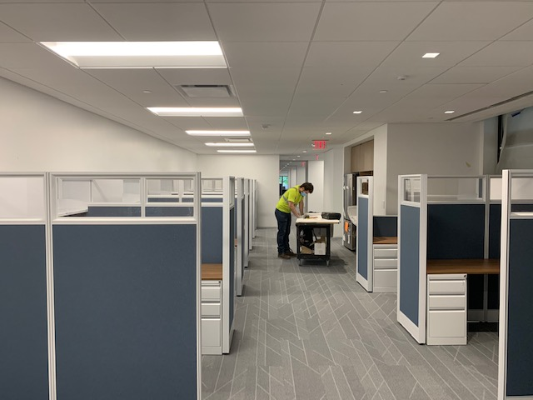
Suite 120 (Front)
New Staff Cubicles

Slide 14
Staff Cubicle View

Slide 15
Manager Cubicle View

Slide 16
Another View Inside Suite 120

Slide 17
Suite 130 View

Slide 18
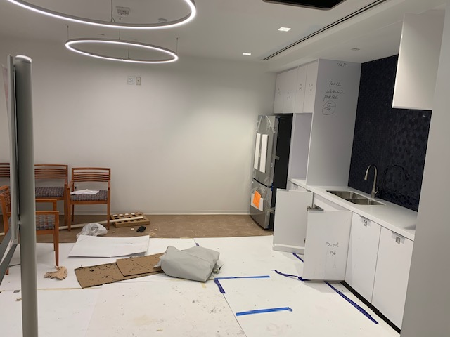
Employee Lounge
Access through Suite 120/130 and Welcome Center

Slide 19
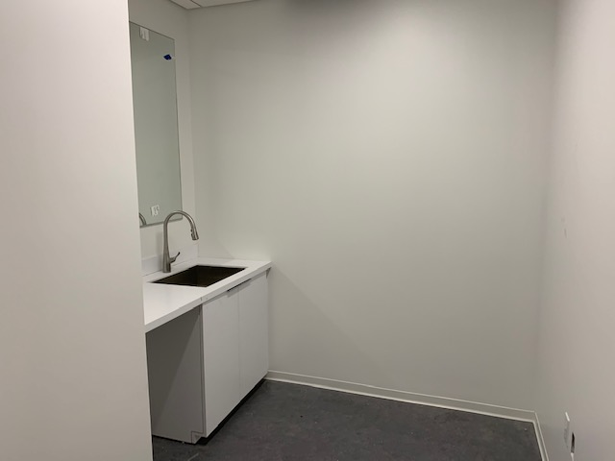
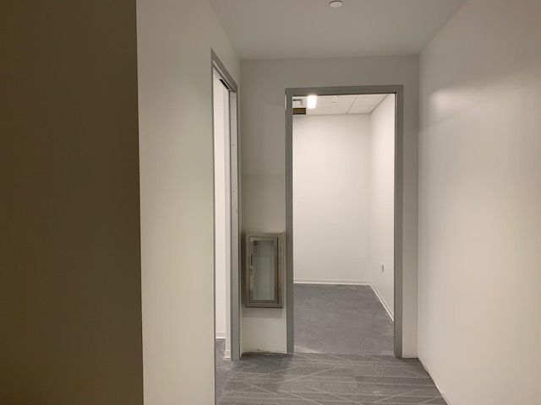
Mother Rooms – Next to Welcome Center Desk
View from Welcome Center Entrance

Slide 20
1st Floor Focus and Conference Rooms

Slide 21
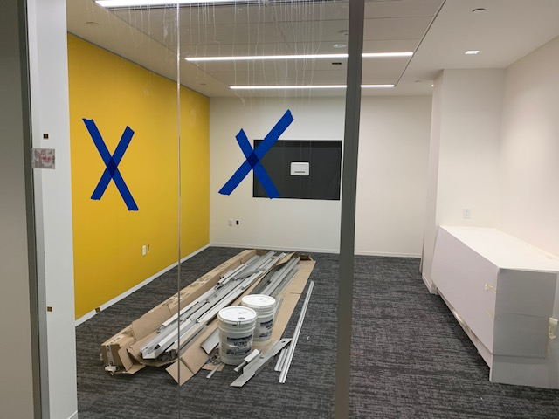
1st Floor Conference Rooms

